Slide 1
NumPy基础知识
Tom Guo Sep 2020

Slide 2


Python基础知识：
Python 是一门与计算机交流的语言。
https://www.python.org/
是一门面向对象的编程的语言

Slide 3
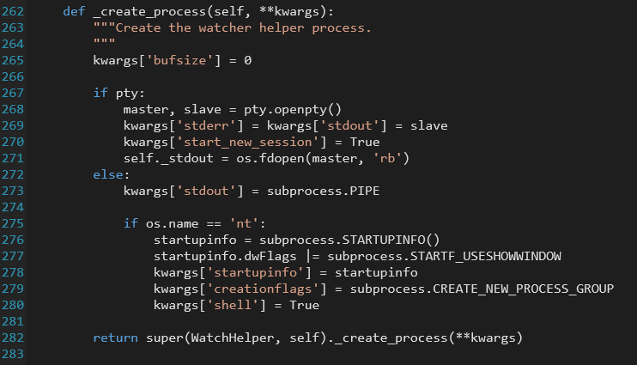
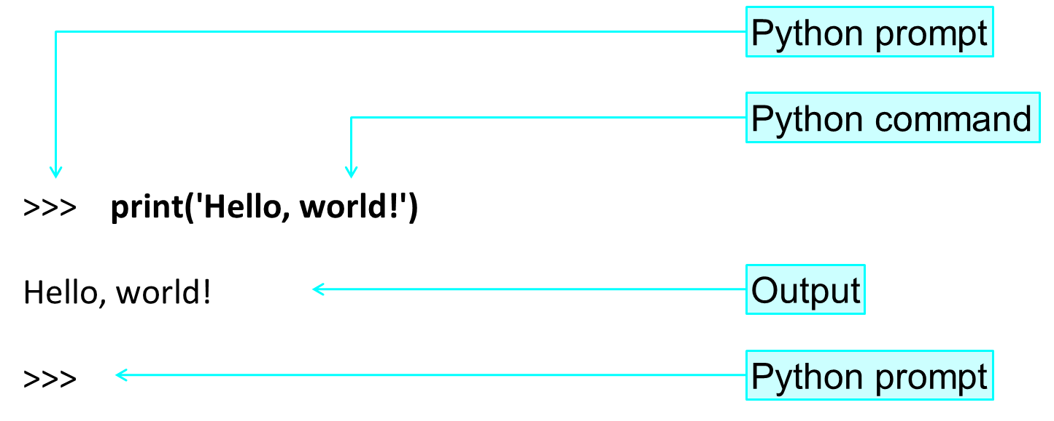
Python的语句
以“#”引导注释

Slide 4
Python的对象
Python 变量类型
变量存储在内存中的值，这就意味着在创建变量时会在内存中开辟一个空间。
基于变量的数据类型，解释器会分配指定内存，并决定什么数据可以被存储在内存中。
因此，变量可以指定不同的数据类型，这些变量可以存储整数，小数或字符。
Python 语言的标识符：
首字符必须是字母或下划线；
其他字符可以是字母、数字或下划线（ 26 个英文字母，可以包含中文字符、日文字符等）。
大小写敏感
避开关键字
变量赋值
Python 中的变量赋值不需要类型声明。
每个变量在内存中创建，都包括变量的标识，名称和数据这些信息。
每个变量在使用前都必须赋值，变量赋值以后该变量才会被创建。
等号 = 用来给变量赋值。
等号 = 运算符左边是一个变量名，等号 = 运算符右边是存储在变量中的值。例如：
abc_xyz：合法。
HelloWorld：合法。
abc：合法。
xyz#abc：不合法，标识符中不允许出现“#”号。
abc1：合法。
1abc：不合法，标识符不允许数字开头。
#!/usr/bin/python # -*- coding: UTF-8 -*-
counter = 100 # 赋值整型变量
miles = 1000.0 # 浮点型
name = "John" # 字符串
x, y , z = 1, 2, “hello”
a = b = 1;
a += 1
关键字：
class, continue, in, for, elif, else, import
lambda …

Slide 5
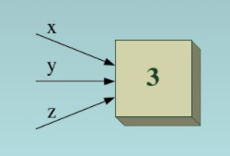
Python的对象
Python 变量的定义：在第一次赋值时自动声明；
Python是一种动态类型的语言；
无处不在的引用：
Python中的每个值（而不是变量）都有一个唯一的标识；
任何变量名之间的赋值都是引用的赋值；
问题：比较
x = 4
y = 4
和
x = y = 4
的异同
x = 3
y = x
z = y

Slide 6
Python的对象
任何类型的值都是一个对象
Python对象的三个特征：
身份：用id()查看；
类型：用type()查看；
值

Slide 7
Python的对象
标准类型
数字
Integer整型 浮点型，长整型，复数型
Boolean布尔型
True, False
String字符串
“Hello world!” ‘Hello world!’ r’Hello world’
List列表
tempList = [1, 2, ‘sample’, 4]
Tuple元组
TempTuple = (1, 2, ‘sample’)
Dictionary字典
dicTemp = {‘XM’:’男’, ‘语文’: 80}
其他的内建类型
Type类型
Null对象
文件
Set集合
函数
模块
类

Slide 8
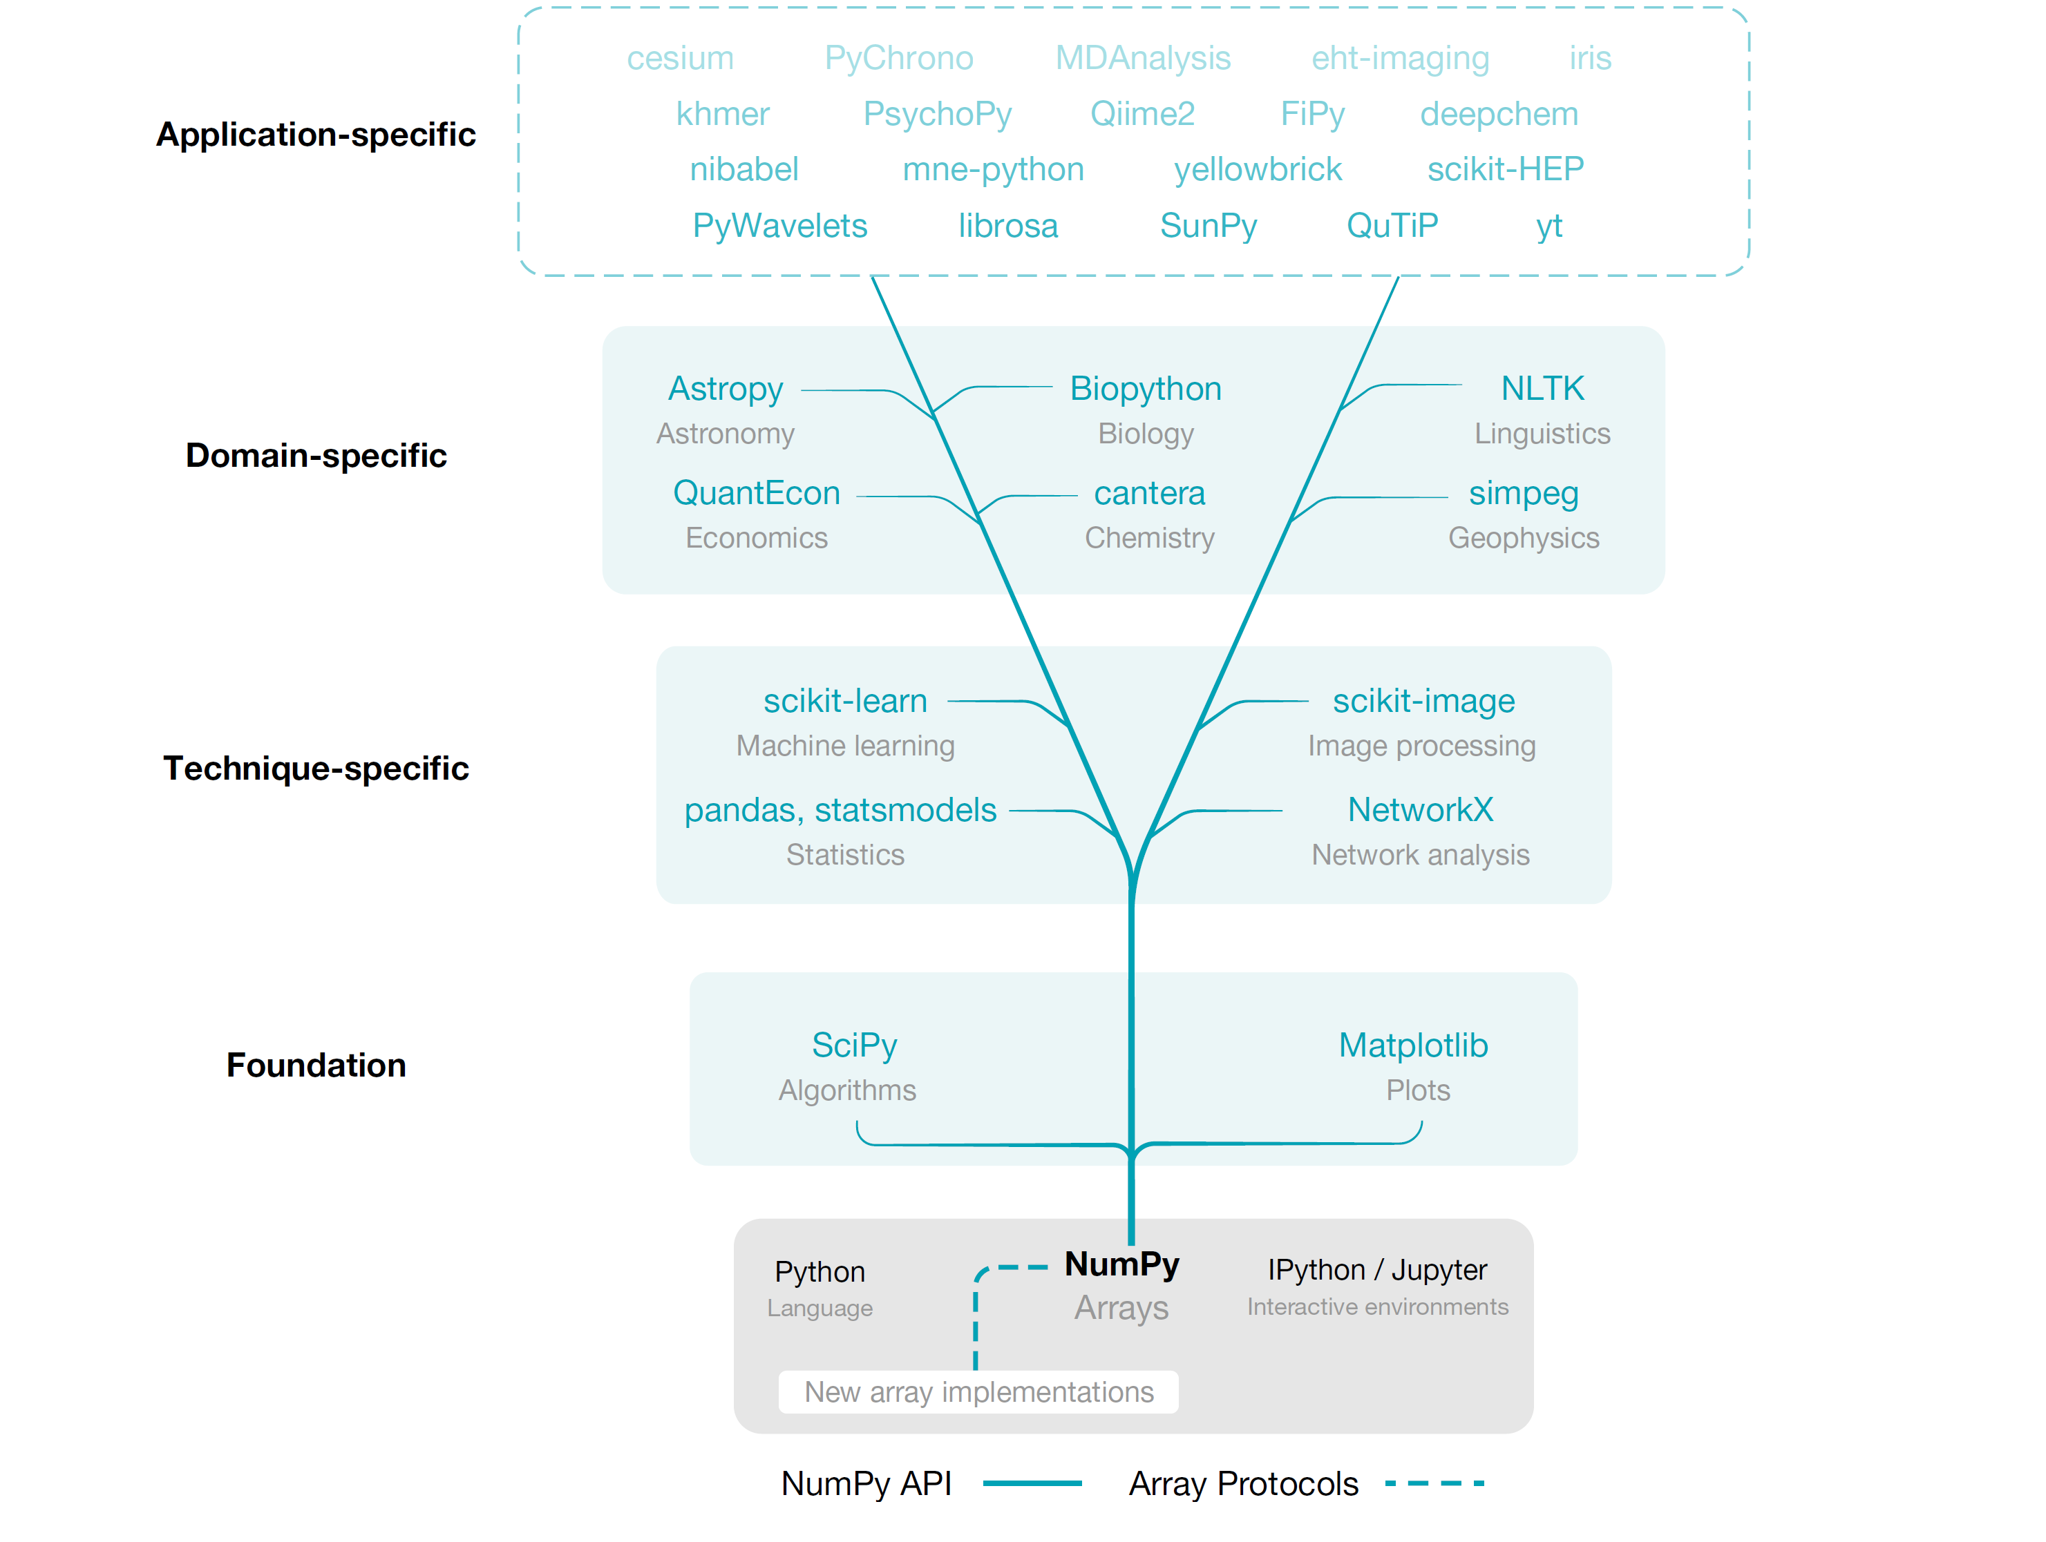

What’s NumPy？
Numeric Python
/ˈnʌmpaɪ/ (NUM-py)
https://www.numpy.org/
https://www.numpy.org.cn/

Slide 9
NumPy基础知识
NumPy是什么？可以做什么？
数组的创建；
NumPy的数组的索引
NumPy的基础运算
NumPy数组的操作
NumPy的copy和deep copy

Slide 10
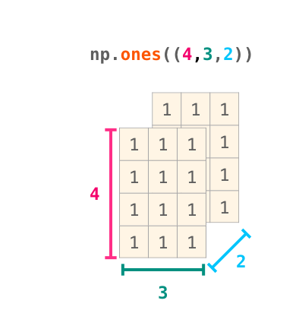
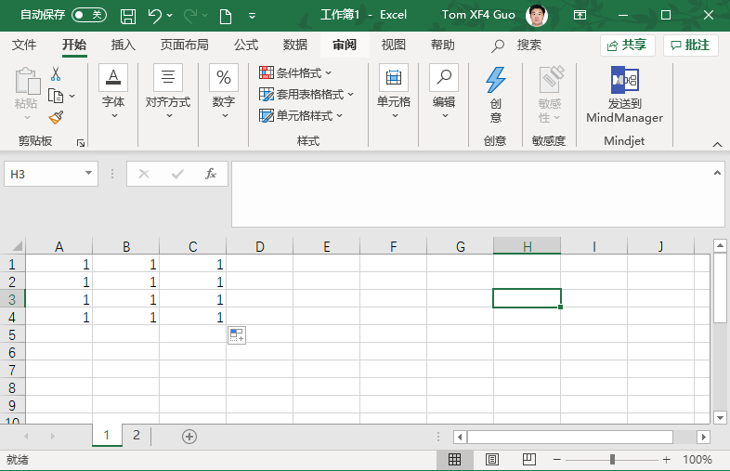
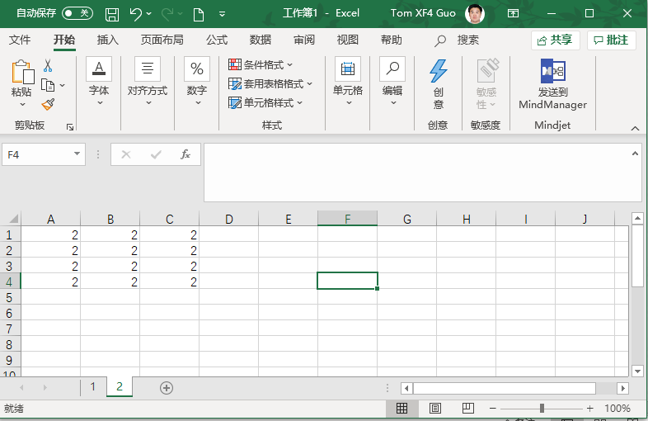
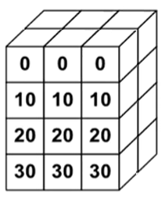
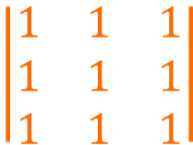
NumPy的核心功能
是Python语言的一个工具包；
import numpy as np
np.ndarray()
为多维大数组和矩阵提供支持；
具有操作这些数组的高等级数学函数集合；
$$\left|\begin{matrix}1 & 1 & 1 \\ 1 & 1 & 1 \\ 1 & 1 & 1\end{matrix}\right|$$
np.max(), np.mean() etc.

Slide 11
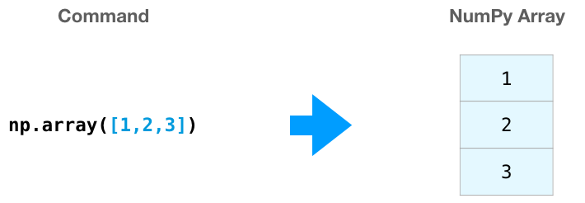
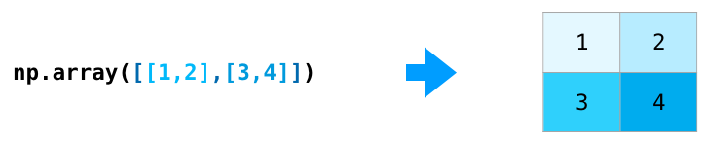
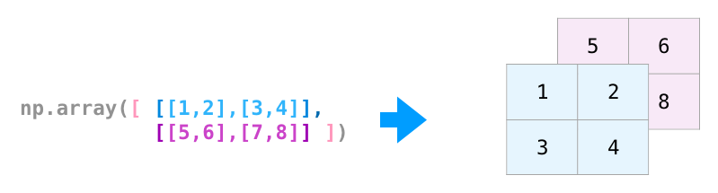
NumPy数组的创建
采用list或迭代器创建
listTemp = [1, 2, 3]
np.array(listTemp)
tupleTemp = (1, 2, 3)
np.array(tupleTemp)
[[1, 2], [3, 4]]
[
[[1, 2], [3, 4]],
[[5, 6], [7, 8]]
]
np.arange(12).reshape((3, 4))
np.linspace(1, 10, 6).reshape((2, 3))
np.array(list, dtype=‘int64’ )

Slide 12
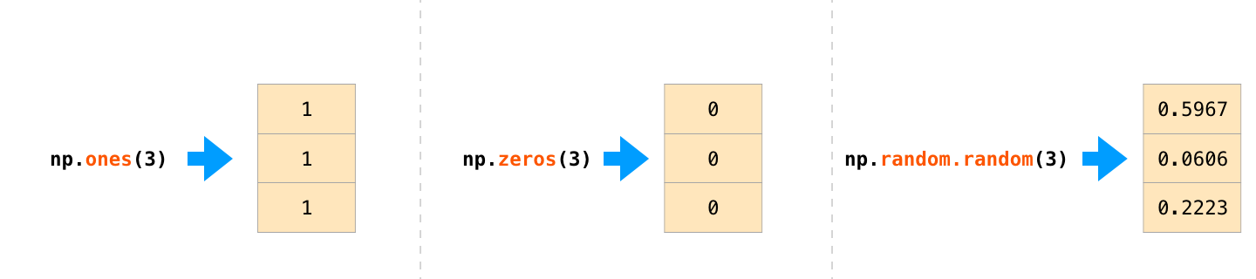
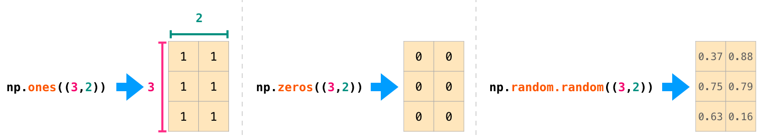

NumPy数组的创建
一些固定的创建方式：
np.empty( (3, 4))

Slide 13
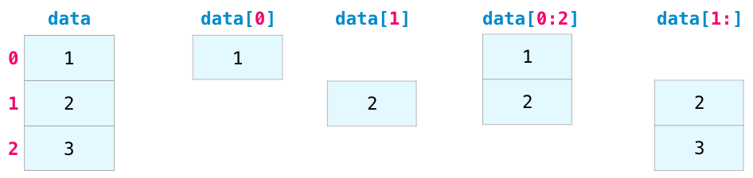
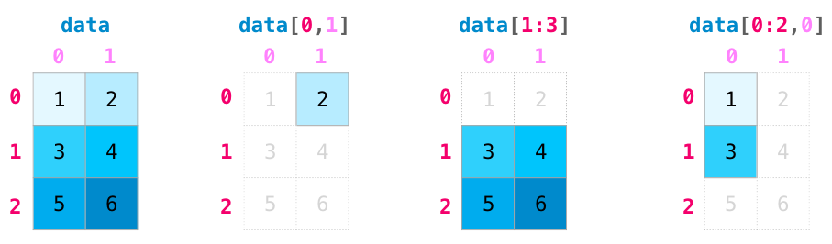
NumPy的数组索引
Matrix Indexing
Indexing and slicing operations become even more useful when we’re manipulating matrices:

Slide 14
NumPy的索引
Bool型索引
迭代的效果
for row in A:
print(row)
for col in A.T:
print(col)

Slide 15
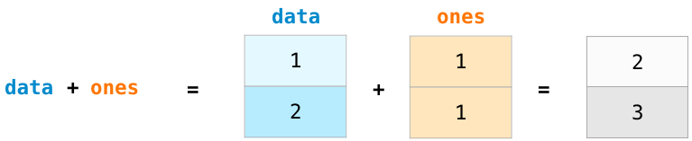
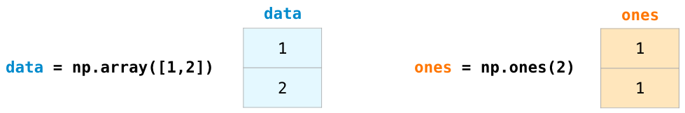
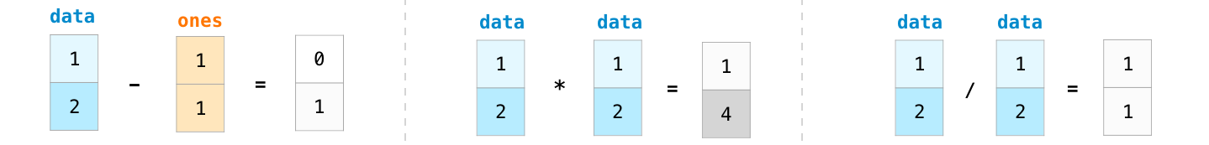
NumPy的简单数据运算
Array Arithmetic

Slide 16
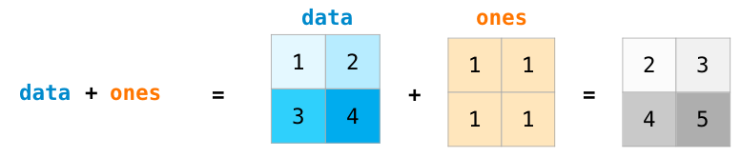
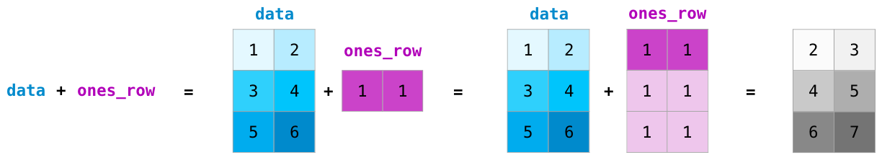
NumPy的简单数据运算

Slide 17
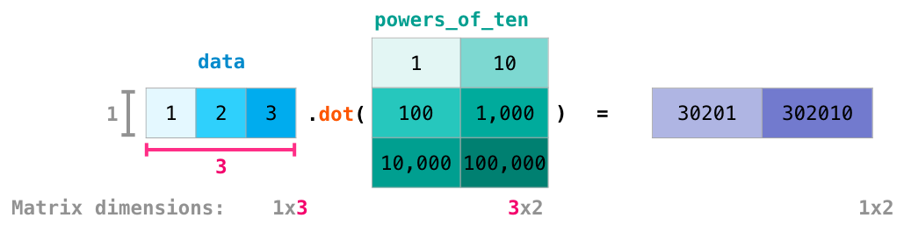
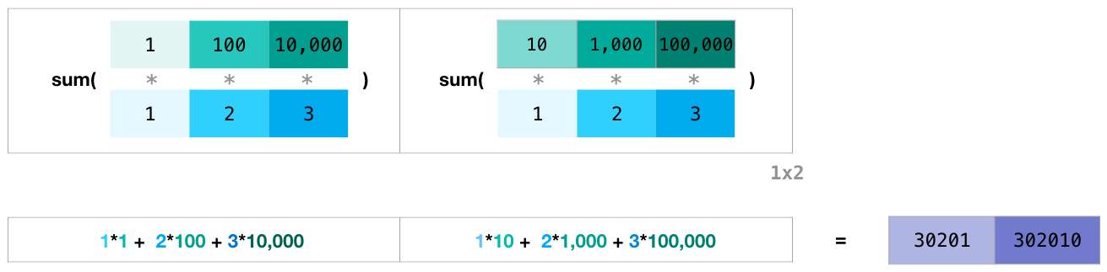
NumPy的简单数据运算
直接乘
np.array([[1, 1],
[0, 1)]
np.array([[0, 1],
[2, 3)]
=
np.array([[0, 1],
[0, 3)]
*
Dot Product

Slide 18
NumPy的简单数据运算
Operator | Equivalent ufunc | Description
+ | np.add | Addition (e.g., 1 + 1 = 2)
- | np.subtract | Subtraction (e.g., 3 - 2 = 1)
- | np.negative | Unary negation (e.g., -2)
* | np.multiply | Multiplication (e.g., 2 * 3 = 6)
/ | np.divide | Division (e.g., 3 / 2 = 1.5)
// | np.floor_divide | Floor division (e.g., 3 // 2 = 1)
** | np.power | Exponentiation (e.g., 2 ** 3 = 8)
% | np.mod | Modulus/remainder (e.g., 9 % 4 = 1)

Slide 19
NumPy的简单数据运算
Trigonometric functions
theta = np.linspace(0, np.pi, 3)
print("theta = ", theta)
print("sin(theta) = ", np.sin(theta))
print("cos(theta) = ", np.cos(theta))
print("tan(theta) = ", np.tan(theta))
Exponents and logarithms
x = [1, 2, 3]
("x =", x)
("e^x =", np.exp(x))
("2^x =", np.exp2(x))
("3^x =", np.power(3, x))
x = [1, 2, 4, 10]
("x =", x)
("ln(x) =", np.log(x))
("log2(x) =", np.log2(x))
("log10(x) =", np.log10(x))

Slide 20
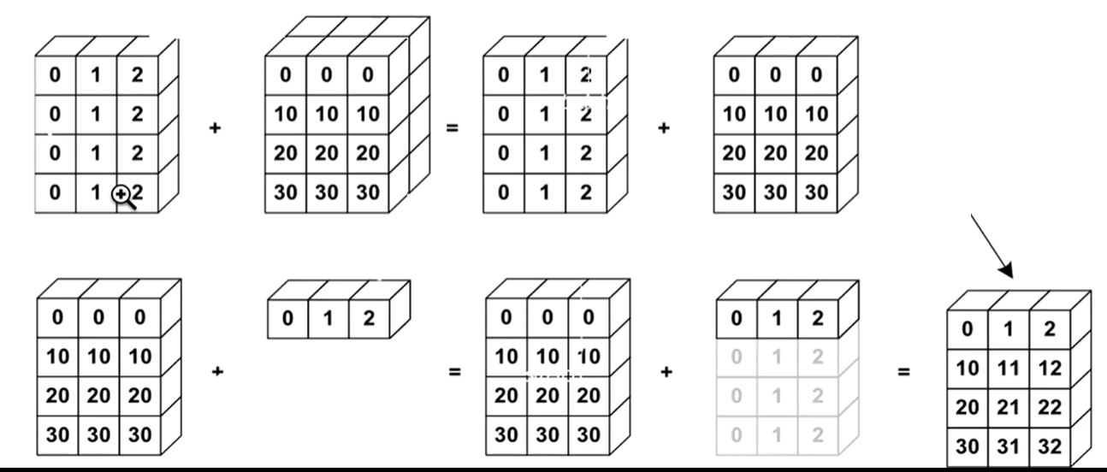
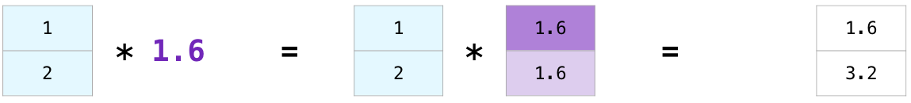
NumPy的简单数据运算
broadcasting

Slide 21
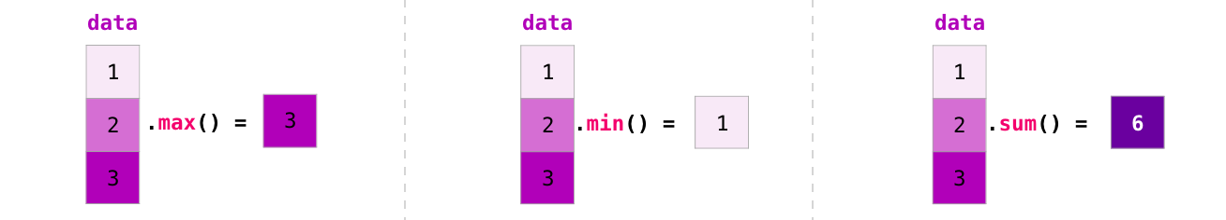
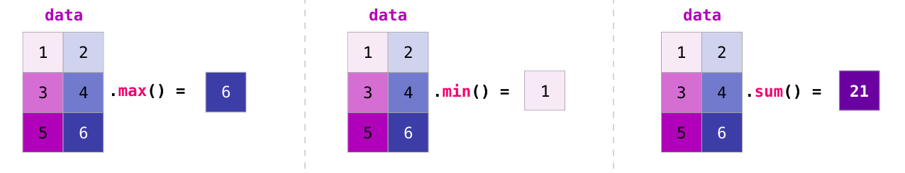
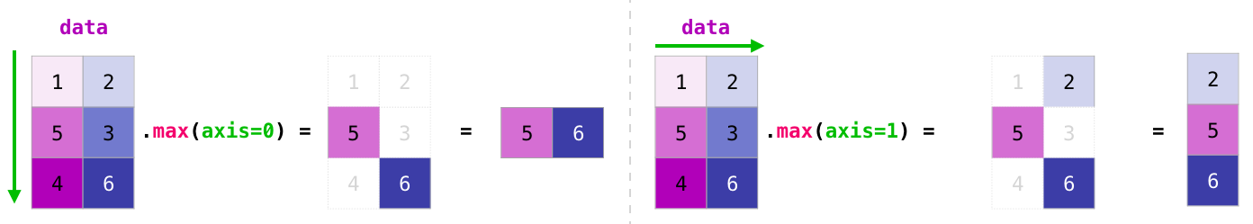
NumPy的简单数据运算
聚合运算

Slide 22
NumPy的简单数据运算
In addition to min, max, and sum, you get all the greats like mean to get the average, prod to get the result of multiplying all the elements together, std to get standard deviation, and plenty of others.
p.sum | np.nansum | Compute sum of elements
np.prod | np.nanprod | Compute product of elements
np.mean | np.nanmean | Compute mean of elements
np.std | np.nanstd | Compute standard deviation
np.var | np.nanvar | Compute variance
np.min | np.nanmin | Find minimum value
np.max | np.nanmax | Find maximum value
np.argmin | np.nanargmin | Find index of minimum value
np.argmax | np.nanargmax | Find index of maximum value
np.median | np.nanmedian | Compute median of elements
np.percentile | np.nanpercentile | Compute rank-based statistics of elements
np.any | N/A | Evaluate whether any elements are true
np.all | N/A | Evaluate whether all elements are true

Slide 23
NumPy的简单数据运算
数据的定位：
A = np.arrange(2, 14).reshape((2, 4))
argmin(A)
argmax(A)
np.nonzero(A)
累加/累差计算：
print(np.cumsum(A))
print(np.diff(A))
print( A >= 5)

Slide 24
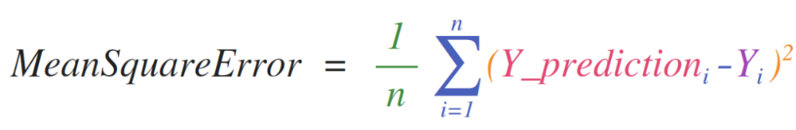
NumPy的简单数据运算
And now for the payoff. Here are some examples of the useful things NumPy will help you through.
Practical Usage
Formulas
Implementing mathematical formulas that work on matrices and vectors is a key use case to consider NumPy for. It’s why NumPy is the darling of the scientific python community. For example, consider the mean square error formula that is central to supervised machine learning models tackling regression problems:
Implementing this is a breeze in NumPy:

Slide 25
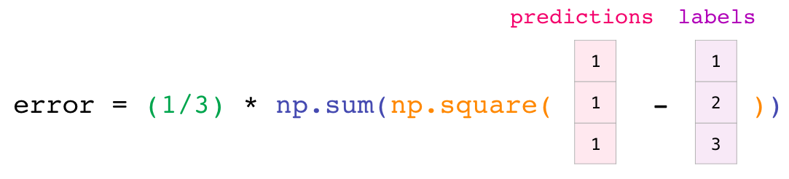
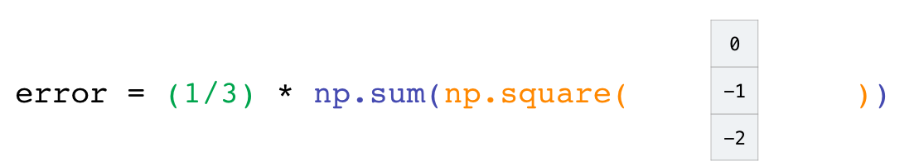
NumPy的简单数据运算
The beauty of this is that numpy does not care if predictions and labels contain one or a thousand values (as long as they’re both the same size). We can walk through an example stepping sequentially through the four operations in that line of code:
Both the predictions and labels vectors contain three values. Which means n has a value of three. After we carry out the subtraction, we end up with the values looking like this:

Slide 26
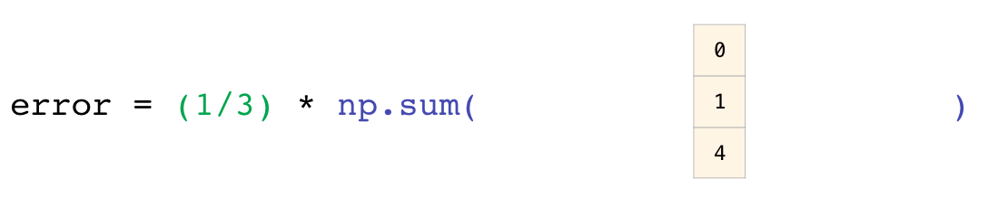
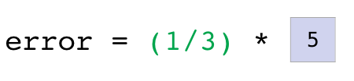
Then we can square the values in the vector:
Now we sum these values:

Slide 27
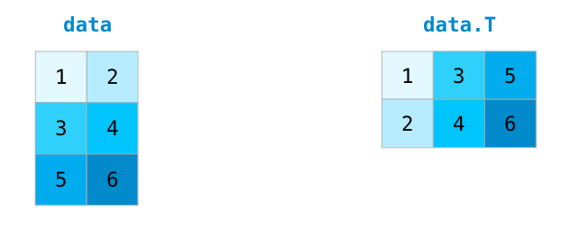
NumPy的数组操作
Np.sort(A)
Np.tranpose(A)
Np.clip(A, 3, 4)
A.flat
A.flatten()

Slide 28
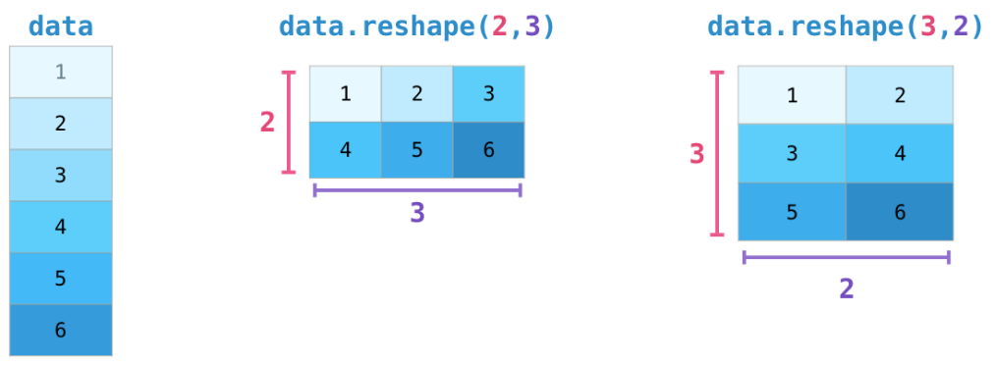
NumPy的数组操作
Transposing and Reshaping
NumPy’s reshape() method
考虑把[1, 1, 1] 序列变为：
[[1],
[1],
[1]]
A[:, np.newaxis]

Slide 29
NumPy的数组操作
数组的合并
Np.array([1,1, 1])
Np.array([2, 2, 2])
Np.vstack((A, B))
Np.hstack((A, B))
[[1, 2],
[1, 2],
[1, 2]]
Np.concatenate((A, B, B, A), axis=0)

Slide 30
NumPy的数组操作
数组的分割
A = np.arrange(12).reshape((3, 4))
Np.split(A, 2, axis=1)
Np.array_split(A, 3, axis=1)
Np.vsplit(A, 3)
Np.hsplit(A, 2)

Slide 31
NumPy数组的copy
A = np.arange(4)
B = A
c= a
D = b
B = A.copy()

Slide 32
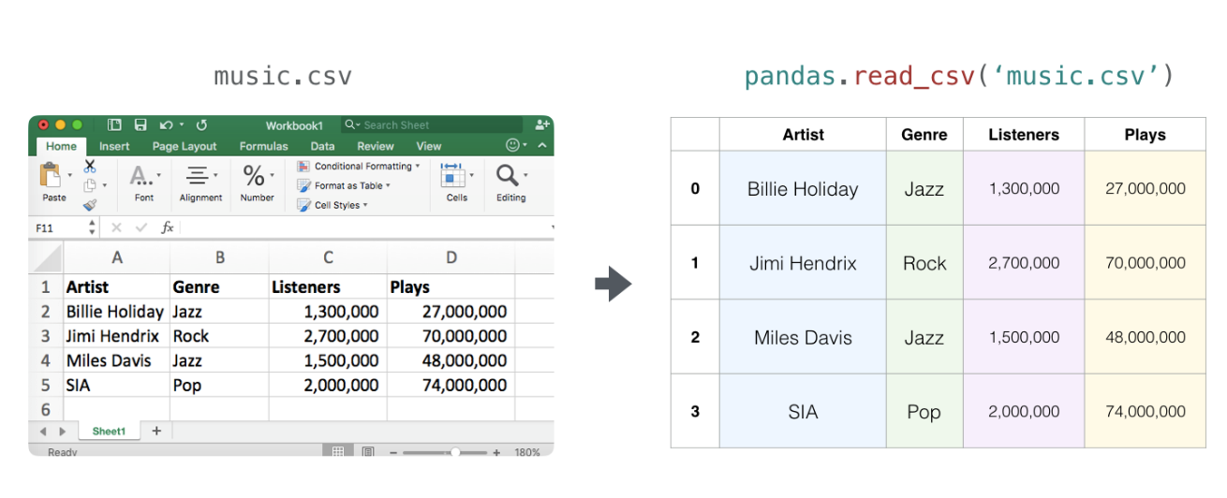
Data Representation
Think of all the data types you’ll need to crunch and build models around (spreadsheets, images, audio…etc). So many of them are perfectly suited for representation in an n-dimensional array:
Tables and Spreadsheets
A spreadsheet or a table of values is a two dimensional matrix. Each sheet in a spreadsheet can be its own variable. The most popular abstraction in python for those is the pandas dataframe, which actually uses NumPy and builds on top of it.

Slide 33
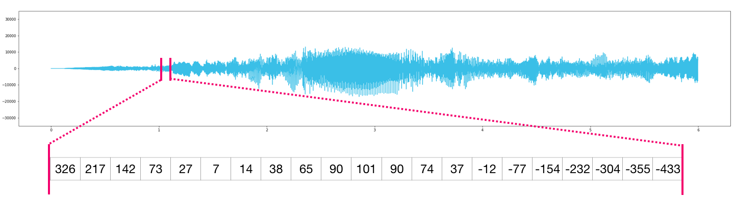
Audio and Timeseries
An audio file is a one-dimensional array of samples. Each sample is a number representing a tiny chunk of the audio signal. CD-quality audio may have 44,100 samples per second and each sample is an integer between -32767 and 32768. Meaning if you have a ten-seconds WAVE file of CD-quality, you can load it in a NumPy array with length 10 * 44,100 = 441,000 samples. Want to extract the first second of audio? simply load the file into a NumPy array that we’ll call audio, and get audio[:44100]. Here’s a look at a slice of an audio file:
The same goes for time-series data (for example, the price of a stock over time).

Slide 34
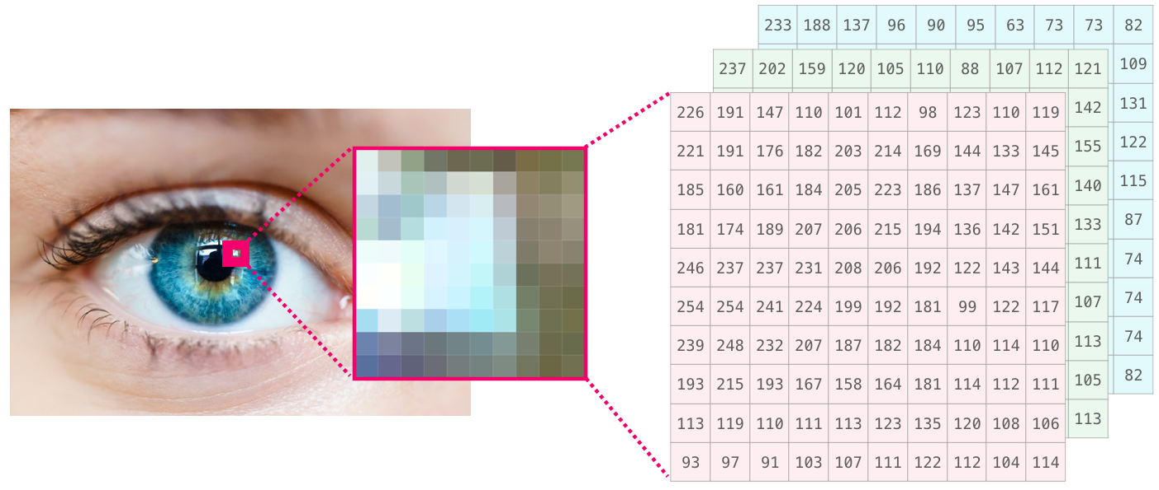
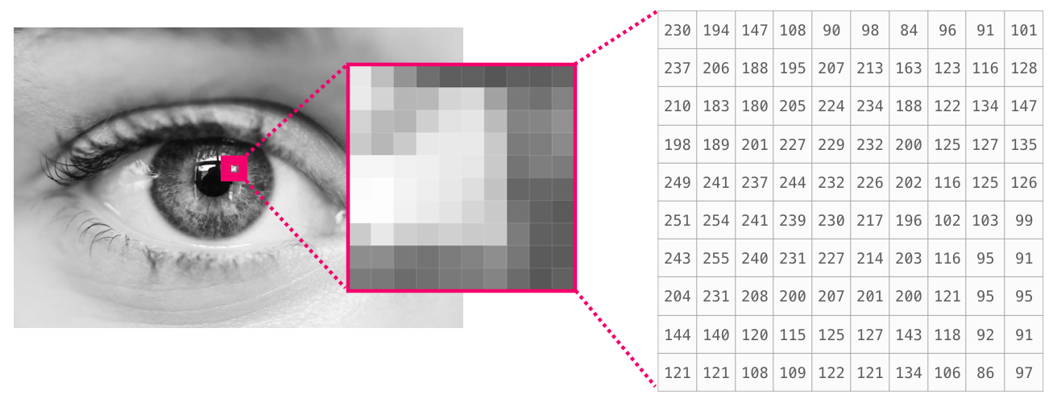
Images
An image is a matrix of pixels of size (height x width).
If the image is black and white (a.k.a. grayscale), each pixel can be represented by a single number (commonly between 0 (black) and 255 (white)). Want to crop the top left 10 x 10 pixel part of the image? Just tell NumPy to get you image[:10,:10].
Here’s a look at a slice of an image file:

Slide 35
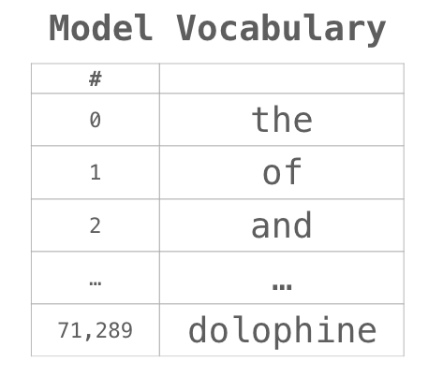
Language
If we’re dealing with text, the story is a little different. The numeric representation of text requires a step of building a vocabulary (an inventory of all the unique words the model knows) and an embedding step. Let us see the steps of numerically representing this (translated) quote by an ancient spirit:
“Have the bards who preceded me left any theme unsung?”
A model needs to look at a large amount of text before it can numerically represent the anxious words of this warrior poet. We can proceed to have it process a small dataset and use it to build a vocabulary (of 71,290 words):
The sentence can then be broken into an array of tokens (words or parts of words based on common rules):
We then replace each word by its id in the vocabulary table:

Slide 36
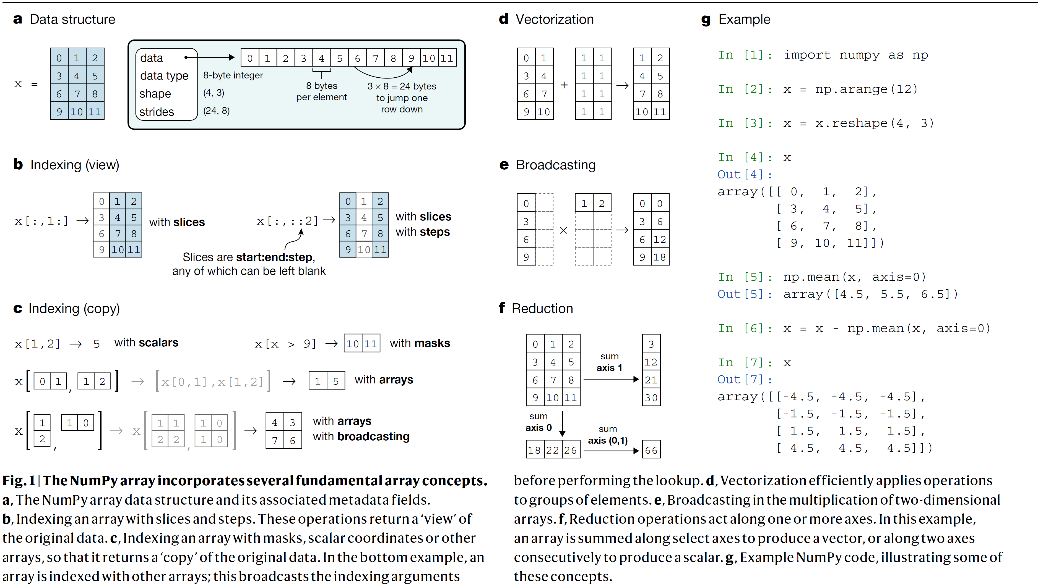

Slide 37
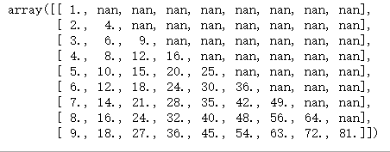
参考资料：
https://jakevdp.github.io/PythonDataScienceHandbook/
https://github.com/jakevdp/PythonDataScienceHandbook
作业：
1）创建列表：
listTemp = [1, 2, 3, 4, 5, 6, 7, 8, 9]
2) 利用1）中创建的列表，创建numpy 数组：
arr1 = array([1, 2, 3, 4, 5, 6, 7, 8, 9])
3）利用arr1创建numpy数组：
arr2 =
array([[1, 1, 1, 1, 1, 1, 1, 1, 1],
[2, 2, 2, 2, 2, 2, 2, 2, 2],
[3, 3, 3, 3, 3, 3, 3, 3, 3],
[4, 4, 4, 4, 4, 4, 4, 4, 4],
[5, 5, 5, 5, 5, 5, 5, 5, 5],
[6, 6, 6, 6, 6, 6, 6, 6, 6],
[7, 7, 7, 7, 7, 7, 7, 7, 7],
[8, 8, 8, 8, 8, 8, 8, 8, 8],
[9, 9, 9, 9, 9, 9, 9, 9, 9]])
作业：
4）利用arr2，计算制作如下乘法表格：

